Slide 1
Index laws 3/4/5

Slide 2
Title: What are indices?
EQ: What is the third, fourth and fifth index law, and how do we use them to solve problems.
Questions:
Notes:
Index law 3: (a^{m})^{n} = a ^{m x n}
When there are indicies inside and out side of a parenthesis, they multiply.
Eg; (x⁴)³ - think about what indicies mean.
(x⁴)³ means (x⁴) x (x⁴) x (x⁴), then use the first index law,
x⁴⁺⁴⁺⁴ ⁼ x¹²
4 + 4 +4 is the same as 4 x 3, therefore we can use the third law to simplify that if an index is inside the bracket, you multiply by the index outside the brackets.

Slide 3

Title: What are indices?
EQ: What is the third, fourth and fifth index law, and how do we use them to solve problems.
Questions:
Notes:
Index law 4: ($a × b)^{2}$ = a² x b² = a²b² OR $(\frac{a}{x}$)³ = $\frac{a^{3}}{x^{3}}$
Combined with index law 3, this law tells us that if we have more than one variable in the parenthesis, both are raised to the index outside.
e.g.
(${3a}^{2}× 2x)^{2}$
= $3^{2}×a^{2×2}×2^{2}×x^{2×2}$
=$9a^{4}$x $4x^{4}$
=36$a^{4}x^{4}$

Slide 4
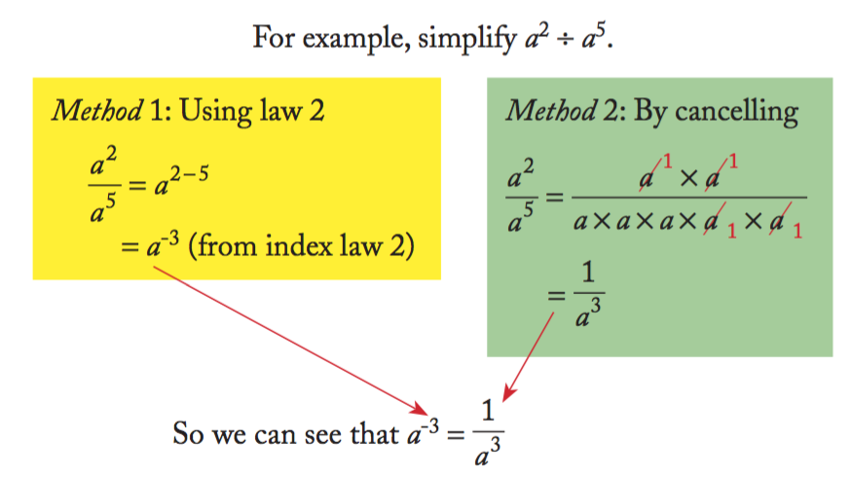


Title: What are indices?
EQ: What is the third, fourth and fifth index law, and how do we use them to solve problems.
Questions:
Notes:
Index law 5: y ⁻³ = $\frac{1}{y^{3}}$
When there is a negative index, we can write it below a one to make it positive.
The example on the right shows how this process of cancelling negative indices can be used to create the positive below a one.
Also- $\frac{1}{x^{−3}}=x^{3}$

Slide 5
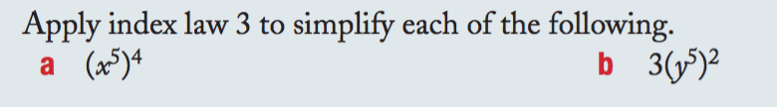
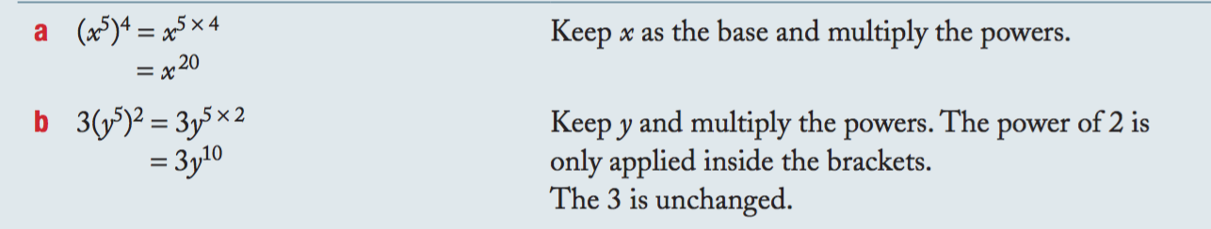
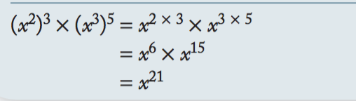
Guided practise
Solve the following using index laws 3/4/5

Slide 6
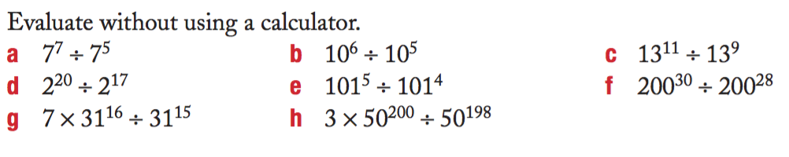
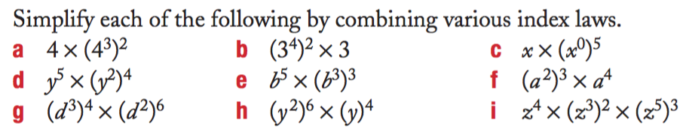
Practise

